Slide 1



LEGAL DOCUMENT SUMMARIZER USING DOMAIN-SPECIFIC MODELS AND REINFORCEMENT LEARNING
An Unsupervised Approach to Multi-Aspect Legal Summarization
Under the guidance of
Ms. Komal Sharma
Kedar Mahajan - BT23CSA033
Koustubh Gadekar - BT23CSA039
Sumedh Lohekar - BT23CSA051
Mangesh Thale - BT23CSA065

Slide 2

Introduction & Motivation
The Problem:
Legal documents (judgments) are dense, lengthy, and structurally complex. Manual summarization is time-consuming and prone to error.
The Need:
A system that not only "shortens" text but preserves legal intent, obligations, and reasoning.
Current Limitation:
General NLP models (T5, BART) struggle with specific legal vocabulary and long-range dependencies.
Our Goal:
Automate the generation of extractive, aspect-specific summaries without relying on expensive human-labeled datasets.

Slide 3
Research Gaps & Objectives
Identified Gaps:
Long Judgments
Multi-Aspect Summarization
Reward Engineering
Domain-Specific Integration
Supervised Bottleneck: Existing RL methods often need reference summaries for rewards.
Project Objectives:
Develop an Unsupervised RL Agent (no ground truth needed).
Integrate InLegalBERT for domain-aware encoding.
Generate 5 specific summaries: Facts, Analysis, Argument, Judgement, Statute.
Create a robust reward mechanism balancing coverage, redundancy minimization, positional relevance, and length efficiency.

Slide 4
Dataset Overview
Data Sources
IN-EXT Dataset: Curated collection of Indian legal judgments with extractive annotations
Indian Kanoon 2025 Cases: Recent judgments from Indian courts providing diverse case types
Data Processing
PDF extraction using PyPDF and pdfplumber libraries to handle various document formats and structures.
Comprehensive cleaning removes OCR noise, standardizes headers and footers, and normalizes formatting inconsistencies.
Final output: Training-ready data optimized for RL and evaluation.

Slide 5
Training Configuration
Unsupervised Policy-Gradient RL
Hardware: NVIDIA Tesla T4
No labeled summaries required—the agent learns entirely from reward signals, enabling scalability across legal domains.
GPU acceleration enables efficient training on long legal documents with thousands of sentences.
Episodic Training with Checkpoints
Regular checkpointing ensures training stability and enables model selection based on validation performance.

Slide 6

Baseline Models Implemented
TF-IDF Ranking
Lead-N
TextRank
Classical frequency-based approach scoring sentences by term importance across the document corpus.
Positional bias baseline selecting first N sentences, exploiting typical legal document structure.
Graph-based algorithm treating sentences as nodes, using similarity for edge weights and PageRank scoring.
Maximal Marginal Relevance
RoBERTa Encoding
Transformer-based sentence embeddings enabling semantic similarity measurement beyond lexical overlap.
MMR balances relevance and diversity, reducing redundancy while maintaining coverage of key points.

Slide 7
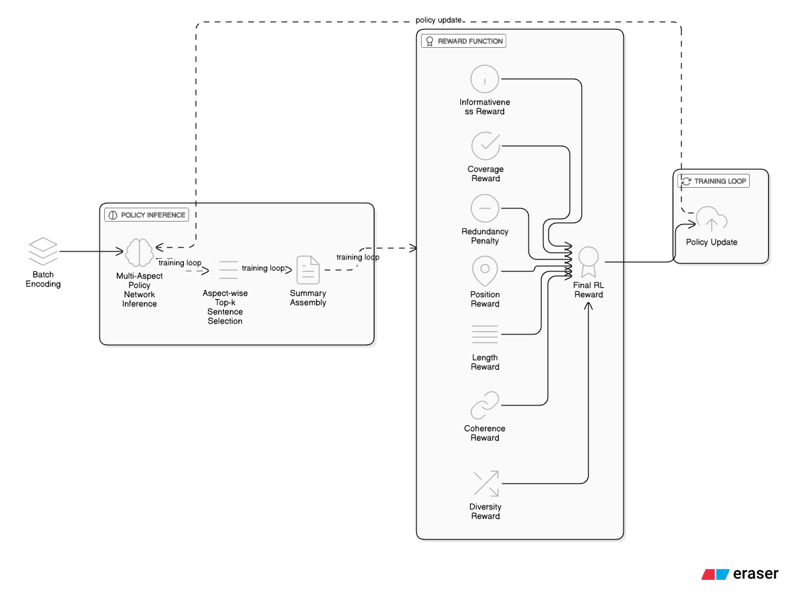
Proposed System Architecture
Encoding Phase
Selection Phase
Optimization Phase

Slide 8

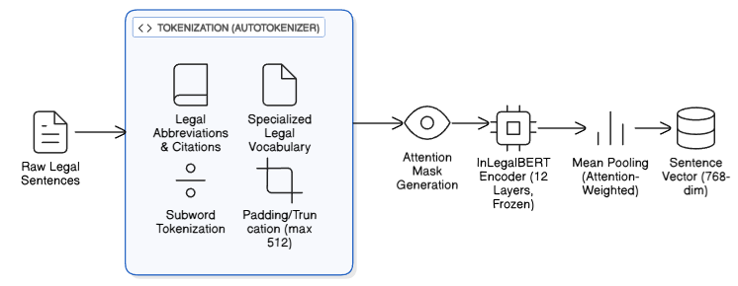
The Sentence Encoder
Model Used:
InLegalBERT (Frozen layers).
Why InLegalBERT?
Unlike standard BERT, it is pre-trained on Indian legal documents, understanding terms like "Petitioner," "Respondent," and specific Acts.
Process:
Tokenization (Handling legal abbreviations like "v.", "Sec.").
Output: 768-dimensional dense vector representations for every sentence.

Slide 9
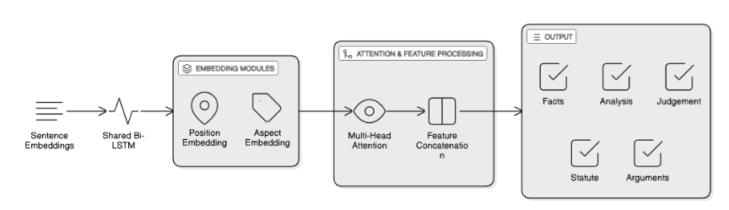
Multi-Aspect Policy Network

Slide 10
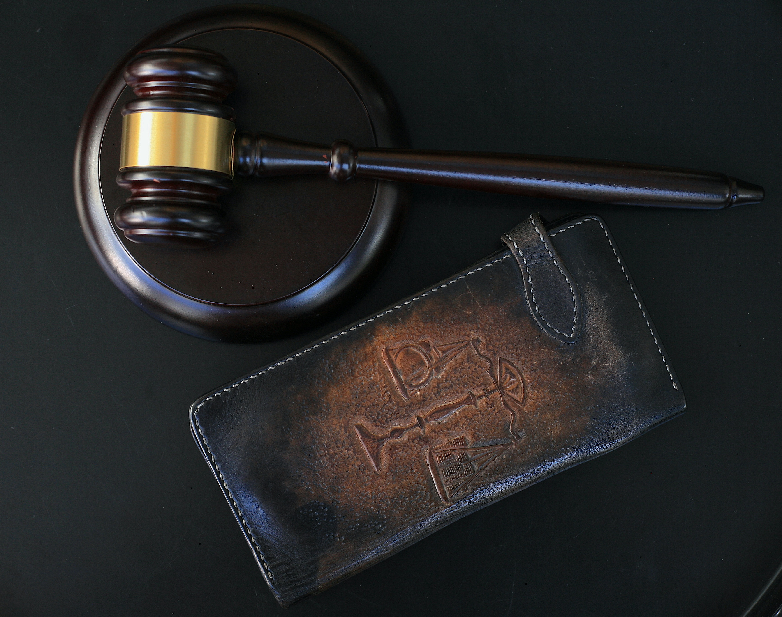
Network Architecture Components
The multi-aspect policy network leverages a shared encoding layer with specialized attention mechanisms to capture distinct rhetorical aspects within legal documents.
Shared Bi-LSTM Encoder
Positional Embeddings
512-dimensional bidirectional LSTM processes sequential sentence embeddings, capturing contextual dependencies across the entire document.
Supports up to 2000 positions, enabling the model to leverage structural information critical in legal document understanding.
Aspect Representation
Multi-Head Attention
Five distinct aspect embeddings (Facts, Analysis, Arguments, Judgement, Statutes) trained to identify rhetorical components.
4-head attention mechanism enables the model to attend to different semantic relationships simultaneously across aspects.

Slide 11
The Core Architecture: Agent & Reference-Free Reward
The Agent (Unsupervised RL Agent)
The Critic (Reference Free Reward)
Role: Acts as the "Policy" that interacts with the document environment.
Role: Replaces the human evaluator; provides the feedback signal.
The Reward Function:
R = α(Coh) + β(Cov) + γ(Div) - δ(Red) + ε(Info) + ζ(Pos) + eta(Len)
Key Functions
Metrics
encode_sentences: Converts text to embeddings.
select_sentences: Uses a Bernoulli distribution to sample sentences based on Policy Network logits.
train_step: Performs the Policy Gradient update (calculating Advantage and minimizing Loss with Entropy regularization).
Coherence: Semantic flow between sentences.
Coverage: Similarity to the original document.
Redundancy: Penalty for repetitive information.
Diversity: Spread of information.
Informativeness: Importance/Centrality of sentences.

Slide 12
The Training Pipeline: Optimization & Lifecycle
Iterative Process: Iterates through num_epochs and batches of legal judgments.
Dynamic Temperature: Adjusts sampling temperature (max(0.3, 1.0 - epoch/total)) to balance exploration vs. exploitation as training progresses.
Learning Rate Scheduler: Uses ReduceLROnPlateau to lower the learning rate when the validation reward stops improving.
Model Management & Stability
Validation: Evaluates the model on the validation set at the end of every epoch.
Checkpointing: Saves the model state (unsupervised_rl_model.pt) only when the validation reward improves (Best Model).
Early Stopping: Halts training if performance doesn't improve after a set number of epochs (Patience = 10) to prevent overfitting.

Slide 13
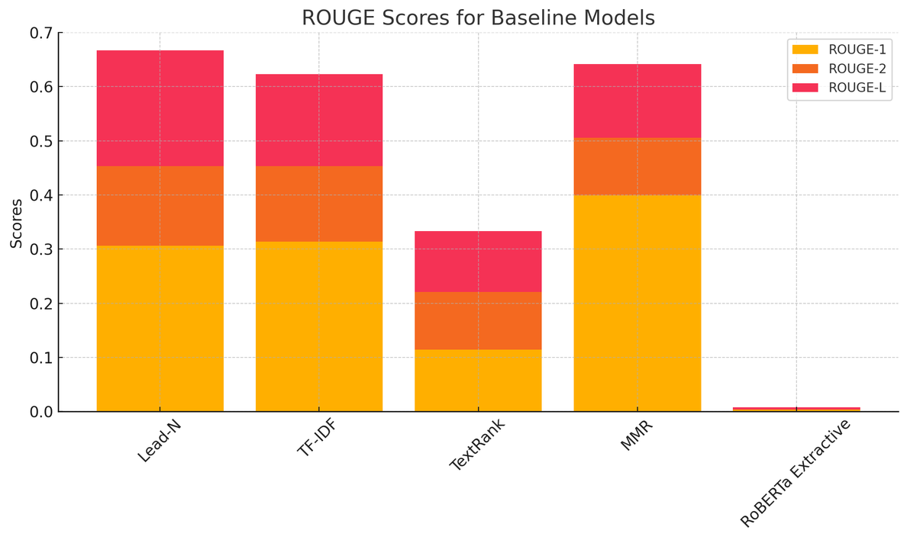
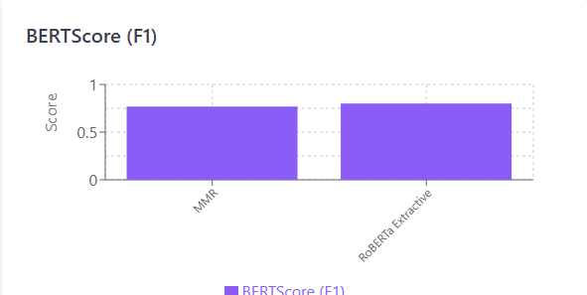
Baseline Comparison
Observations
Traditional methods (Lead-N, TextRank) perform poorly on semantic metrics.
MMR achieves the highest ROUGE-1 score (0.399) while Lead-N has the highest ROUGE-2 score (0.147)
TextRank performs consistently low across all ROUGE scores, whereas TF-IDF delivers a more balanced and stable performance across the same evaluation metrics.
RoBERTa Extractive achieved the highest BERTScore (0.80), proving that neural models capture meaning better than keyword-based models.

Slide 14
Training Dynamics & Validation Results
Comparative performance analysis of the baseline vs. advanced model architectures.
Model 1: IN-Ext
Model 2: Indian Kanoon
Dataset Size 50 Files
Training Config 50 Epochs
Validity Reward 0.6520
Analysis: Achieved a higher reward score primarily due to the dataset containing cleaner, pre-processed text with less structural noise.
Dataset Size 400 Files(PDFs)
Training Config 10 Epochs
Validity Reward 0.5808
Analysis: The slight dip in reward reflects the complexity of real-world data (OCR noise, length variability) but demonstrates robust generalization.

Slide 15
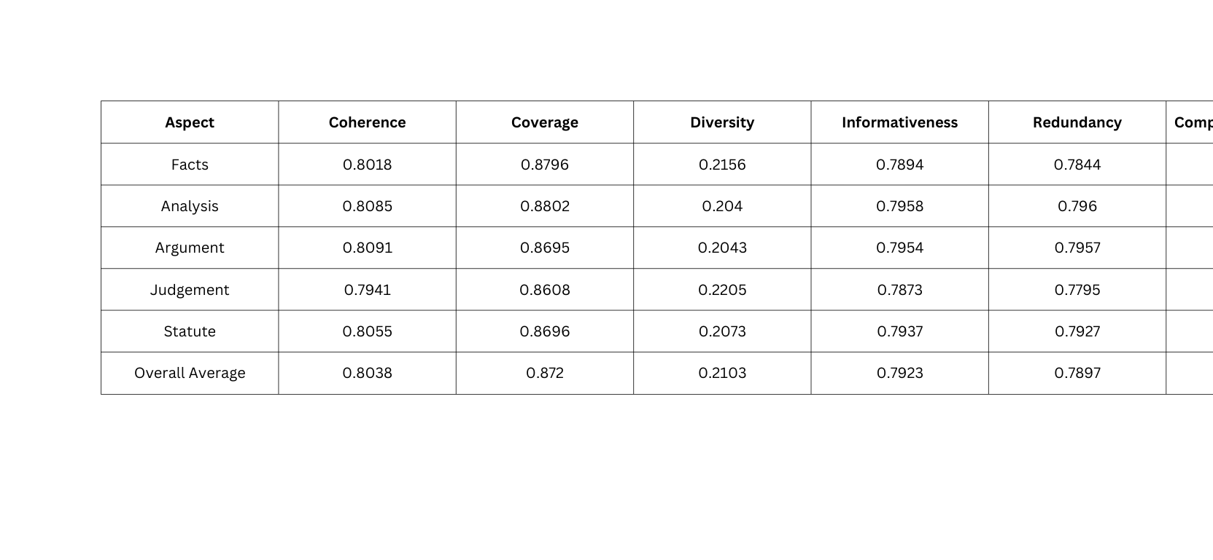

Evaluation of Model 1
Semantic Evaluation
Quantitative Metrics

Slide 16
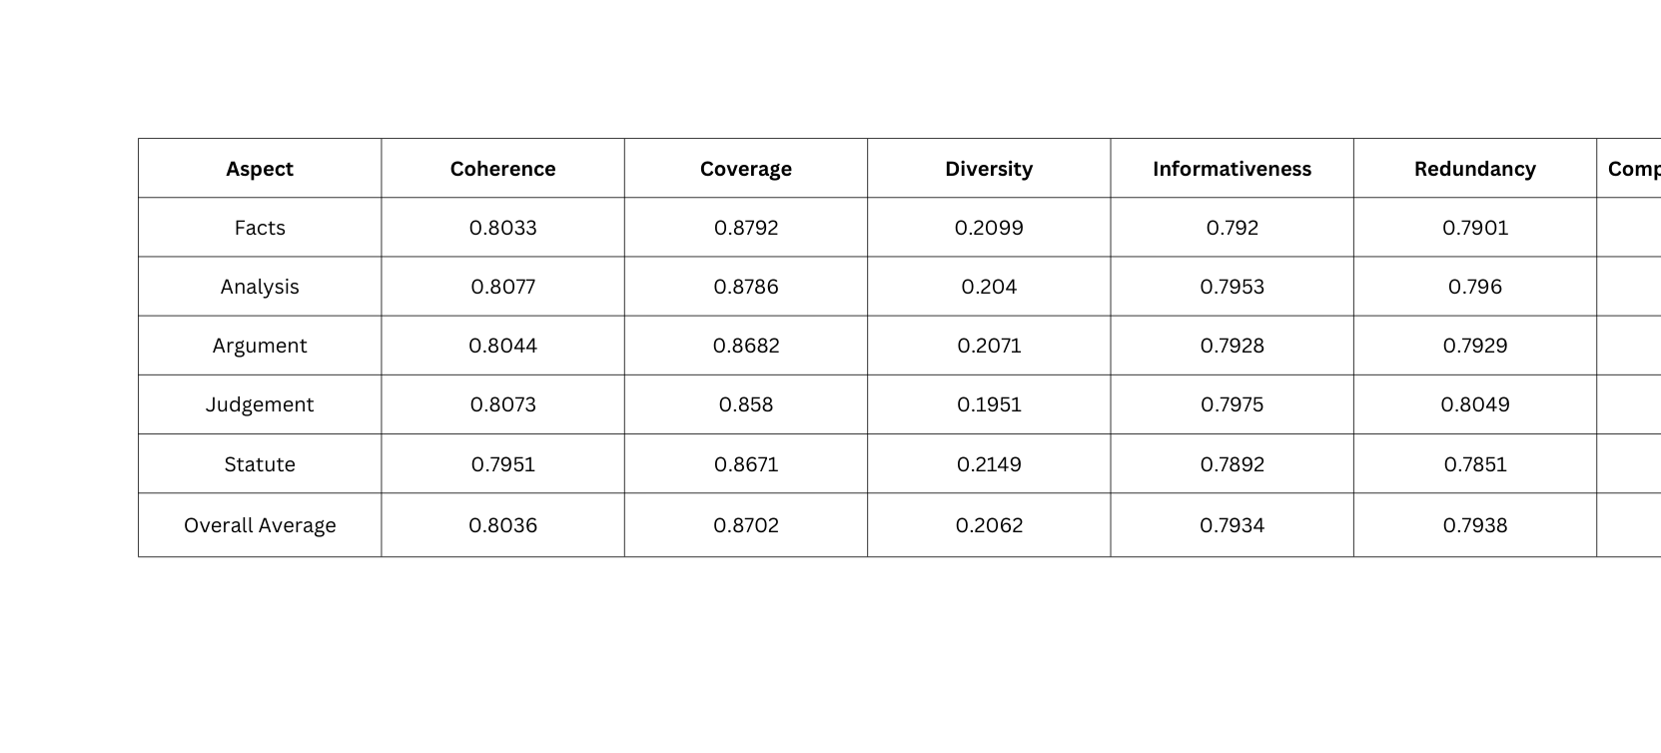
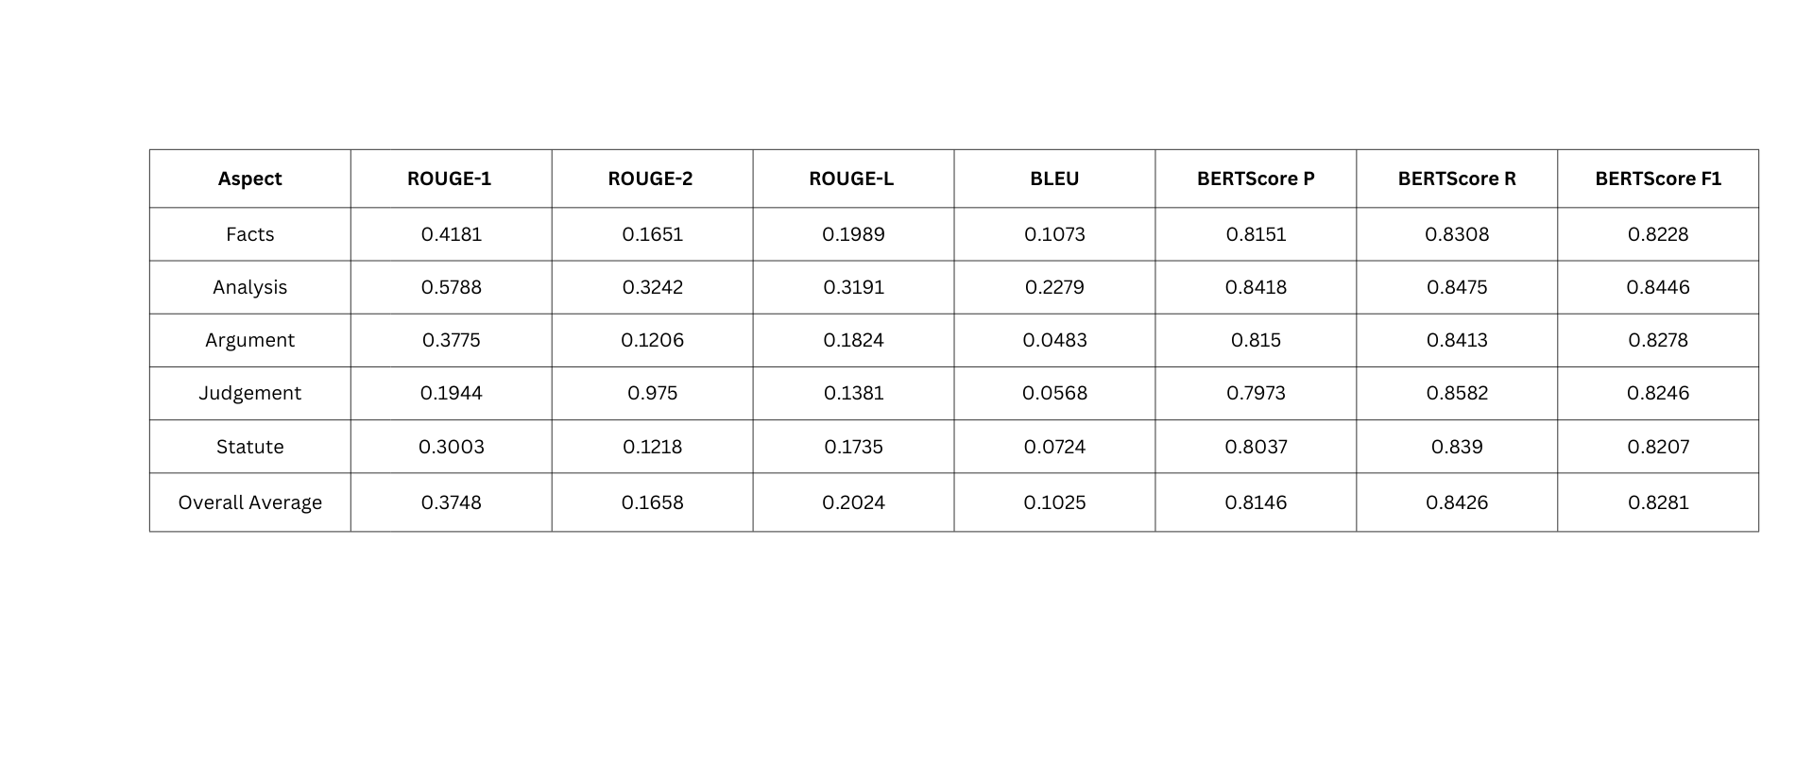
Evaluation of Model 2
Semantic Evaluation
Quantitative Metrics

Slide 17
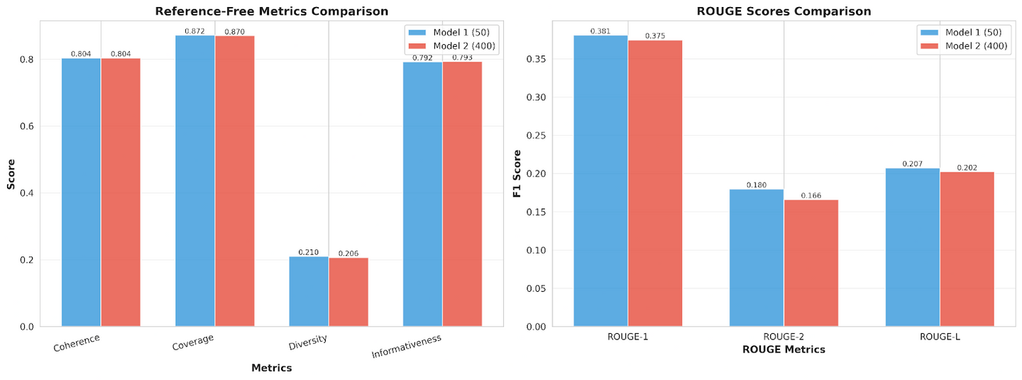
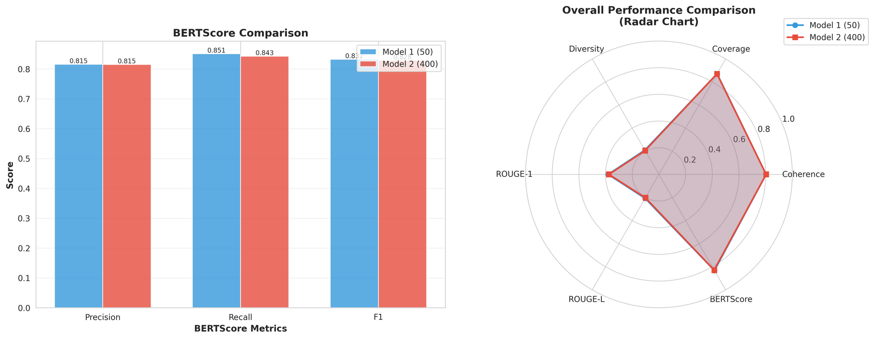
Comparative Analysis (Model 1 vs. Model 2)
Context: Model 1 (Small, Clean Data) vs. Model 2 (Large, Noisy PDF Data).
Findings:
Robustness: Model 2 maintains high Coherence (0.80) and Coverage (0.87) even on complex, noisy PDFs.
Conciseness: Model 2 achieves better compression (8.73%) than Model 1 (9.02%), meaning it is more efficient at filtering noise.
Semantic Match: Both models achieve BERTScore F1 > 0.82, indicating high factual accuracy.

Slide 18
Conclusion & Future Scope
Conclusion:
We successfully demonstrated that Unsupervised RL + InLegalBERT can generate high-quality, multi-aspect legal summaries without needing labeled training data.
Key Wins:
Eliminated dependency on human-annotated datasets.
Effective handling of long documents (>500 sentences).
Future Work:
Multilingual Support: Extending to Hindi/regional legal texts.
Abstractive Layer: Adding a T5/BART layer on top for paraphrasing (Hybrid approach).
Citation Graphing: Visualizing links between case laws.

Slide 19
References
Key research contributions advancing legal text summarization and AI-driven legal document analysis.
[1] Wang & Wu (2024)
[2] Shukla et al. (2022)
[3] Elaraby & Litman (2022)
Reinforcement learning SAC-VAE framework for legal text summarization. PLOS ONE, 19(10), e0312623.
Extractive and abstractive methods for legal case document summarization. AACL-IJCNLP, pp. 1048–1064.
ArgLegalSumm: Improving abstractive summarization with argument mining. COLING, pp. 6187–6194.
[4] Klaus et al. (2022)
[5] Chalkidis et al. (2020)
[6] Hendrycks et al. (2021)
EUR-LexSum: Multi- and cross-lingual dataset for long-form legal summarization. EMNLP, pp. 7626–7639.
Legal-BERT: Domain-specific language model for legal text processing. arXiv:2010.02559.
CUAD: Expert-annotated NLP dataset for legal contract review. arXiv:2103.06268.
[7] Zhang et al. (2020)
[8] Patil, P., & Patankar, A. (2025)
[9] Sharma et al. (2021)
Reinforcement learning approaches to summarization. TACL, 8, pp. 1–18.
Reinforcement learning for optimizing legal summarization models. TechRxiv.
Section-wise summarization using hierarchical attention networks. IJCNLP.

Slide 20

Thank you
Understanding the Legal Profession

